Slide 1

OGC API - Common and OGC API - Features Sprint Day 1|
September 29th, 2020
Sprint Sponsored by
#OGCAPI

Slide 2
Housekeeping
Only switch your microphone on when speaking.
Follow the chair/facilitator’s instructions.
Say your name before speaking...
“Hi, this is Gobe…”

Slide 5
Welcome
What is an OGC Code Sprint?
A collaborative and inclusive event driven by innovative and rapid programming with minimum process and organization constraints to support the development of new applications and open standards.
The scope of the code sprint is to include:
API implementation
API testing and feedback
Discussion and knowledge sharing
Objectives of the code sprint
Develop prototype implementations of OGC API – Common – Part 2: Geospatial Data
Develop prototype implementations of OGC API – Features – Part 4: Simple Transactions
Test the prototype implementations
Provide feedback to the Editor about what worked and what did not work
Provide feedback about the specification document, especially what is missing from the document

Slide 6
Motivation
APIs are a popular, effective method for rapid software development
There is an increasing need for interoperability between Web APIs
The growing uptake of location within and beyond geospatial developer communities

Slide 7

Thank you to the Sprint Sponsor

Slide 8
Ways of Working
Participants are welcome to bring partial or complete implementations of servers or clients to support the sprint.
Participants will have the opportunity to experiment with parts of the specification and develop working services.
This development can either be done with:
source data that participants bring to the event themselves, or
source data made available by other organizations.

Slide 9
Sprint Cycle
Discuss in Telecon
Implement
Discuss on Gitter
Demonstrate

Slide 10
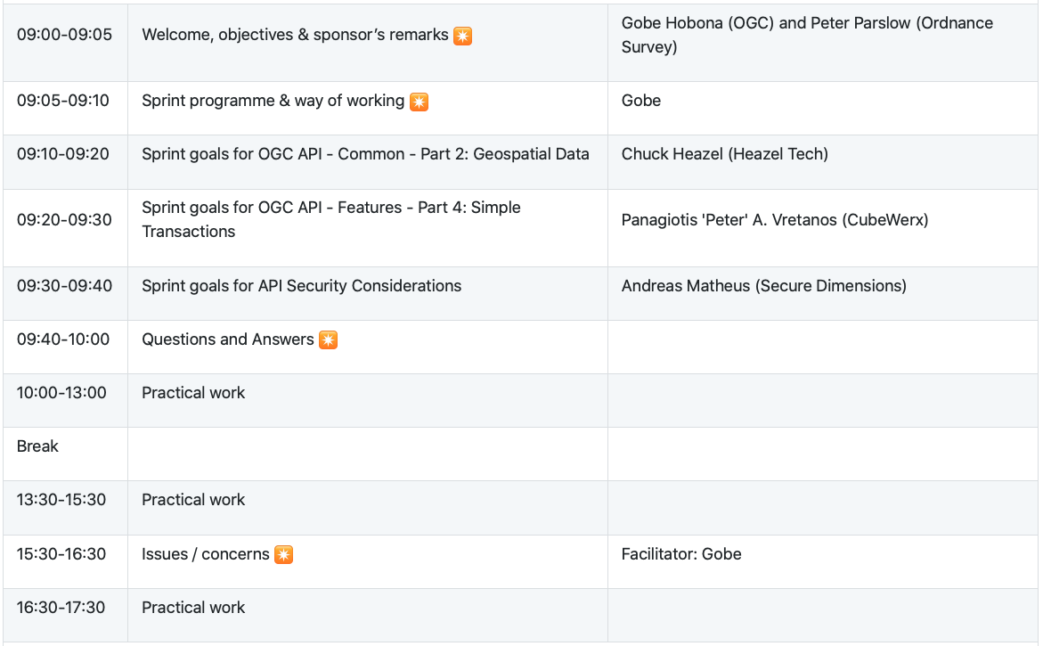
Sprint Schedule: September 29th, 2020
We are here

Slide 11
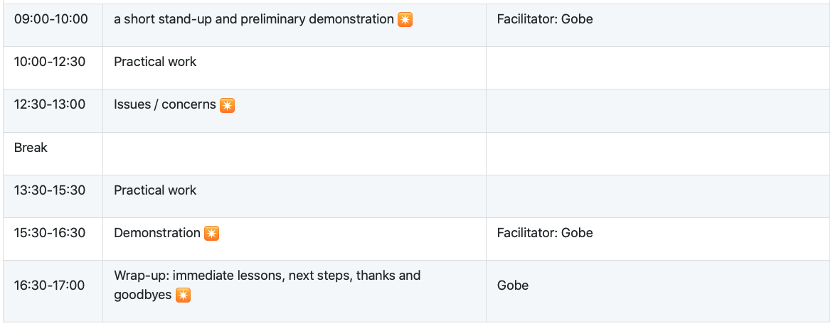
Sprint Schedule: September 30th, 2020

Slide 12
Cost-Share Funding
Without commitment, there may be some funding available for participants to offset their labor costs. Below are the details.
The application form for the potential cost-share funding is at https://docs.google.com/forms/d/1XYEXlgMp3ascx99TGKnvMfukg1ktAlo7jC5YBN-TzD0/viewform
To be eligible for the funding, the participants:
must be OGC Members in good standing.
must have registered to participate in the sprint before 09:00am EDT on September 29th , 2020.
must spend at least 16 hours participating in the sprint during the two-day sprint
must complete and submit an application for cost-share funding before 05:00pm EDT on October 2nd, 2020
Note that applying for the funding is not a guarantee that any funding will be provided. OGC will calculate the funding to award based on the number of applications received.

Slide 13
Logistics
Gotomeeting
Link to be provided to registered participants only.
Gitter
https://gitter.im/opengeospatial/OGC-API-Sprint-September-2020
GitHub
Sprint repo https://github.com/opengeospatial/OGC-API-Sprint-September-2020

Slide 14
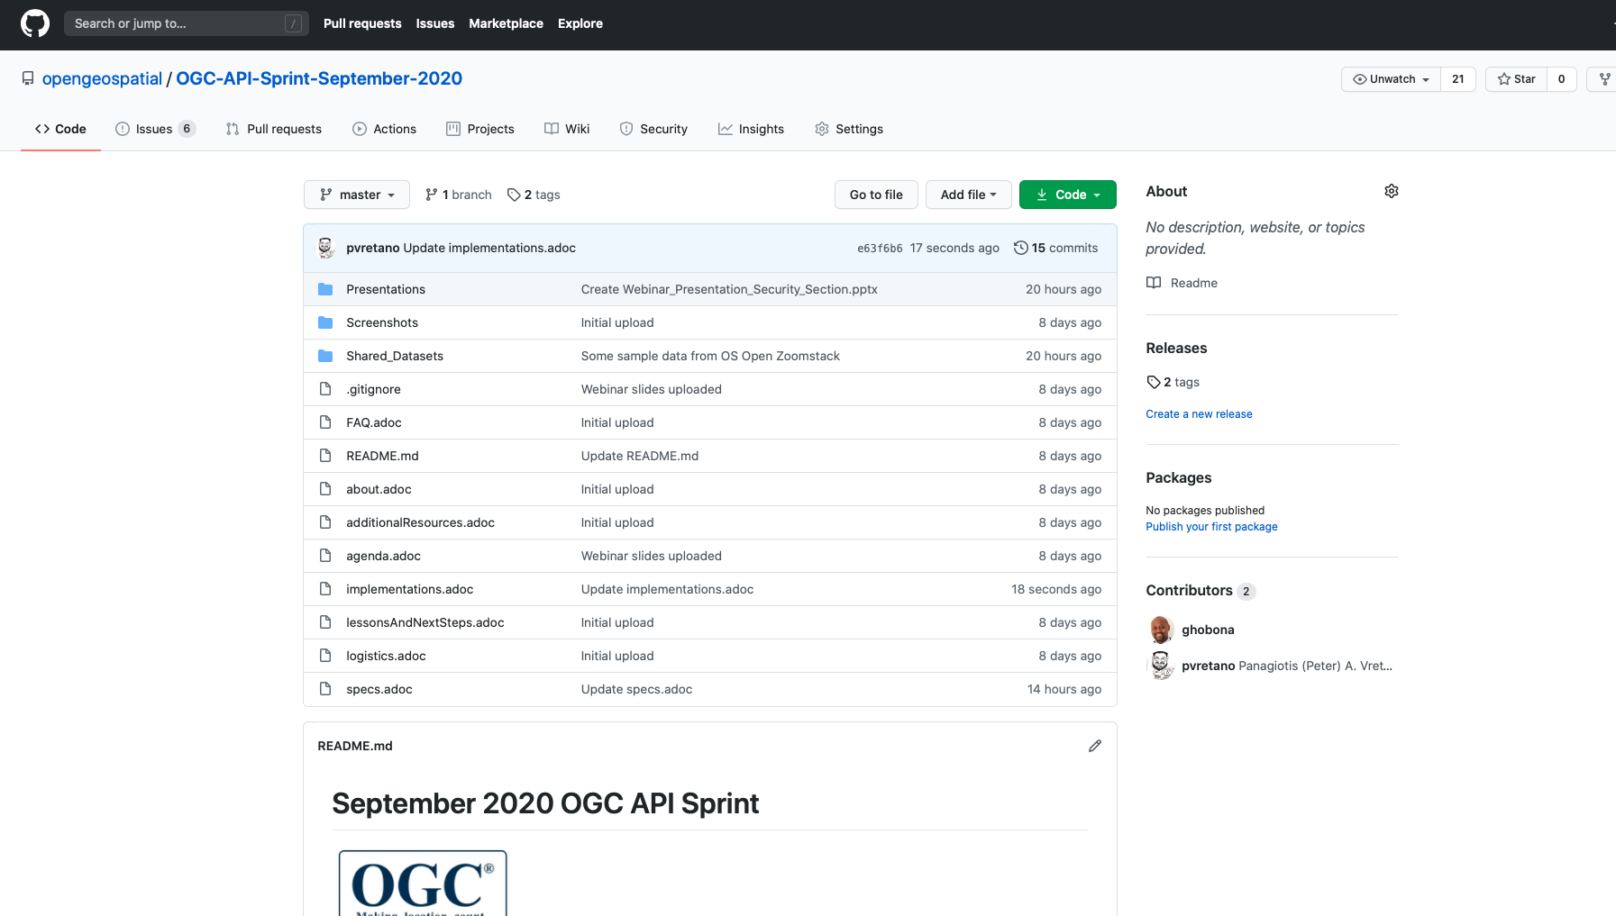

Slide 15
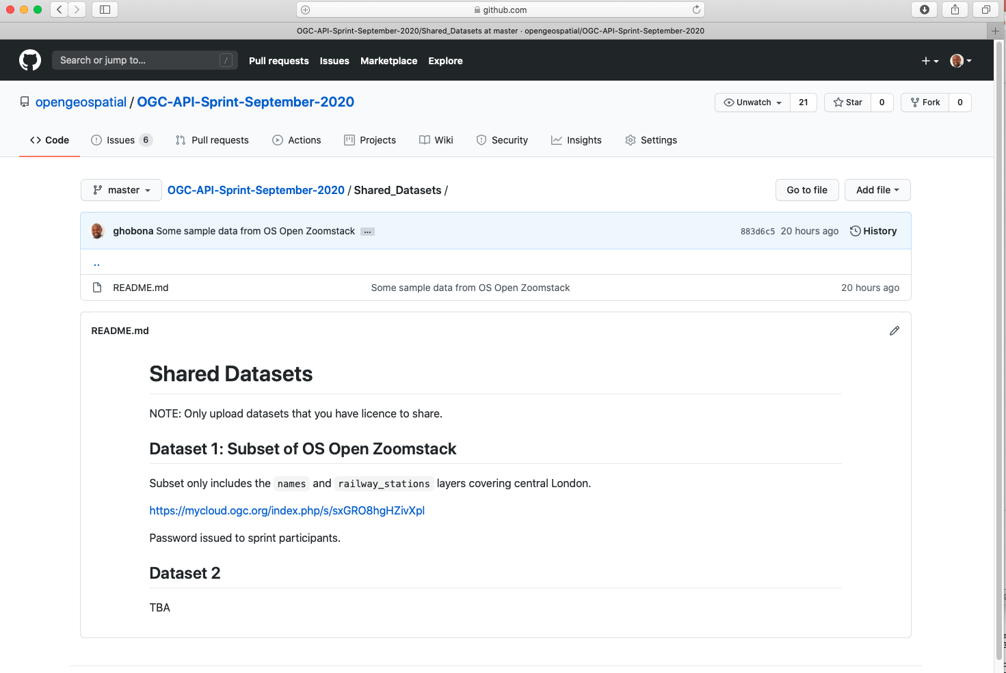
Notes:
https://mycloud.ogc.org/index.php/s/sxGRO8hgHZivXpl

Slide 16
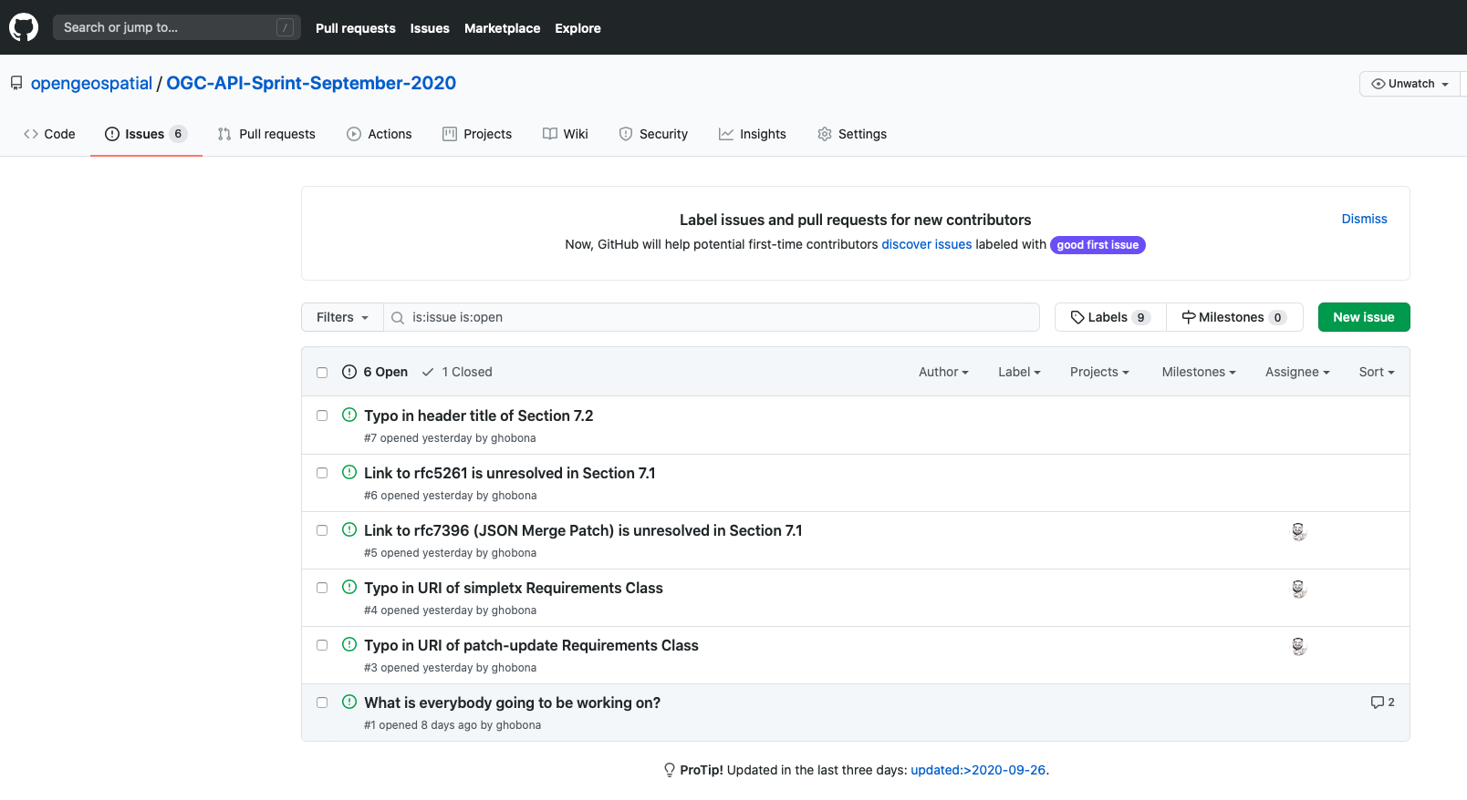

Slide 17
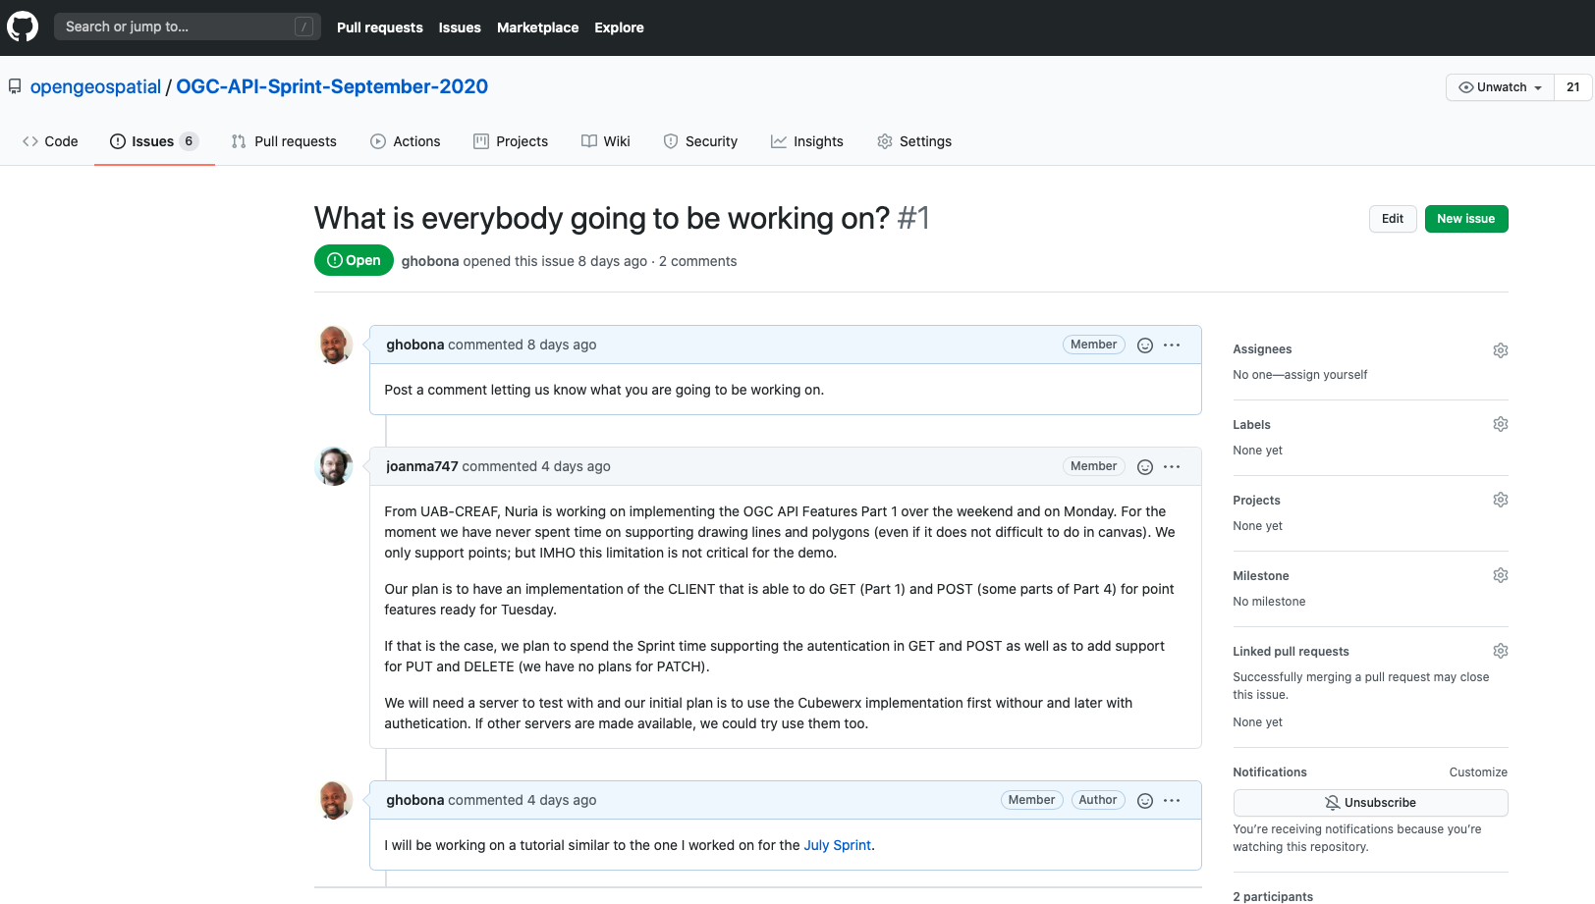

Slide 18
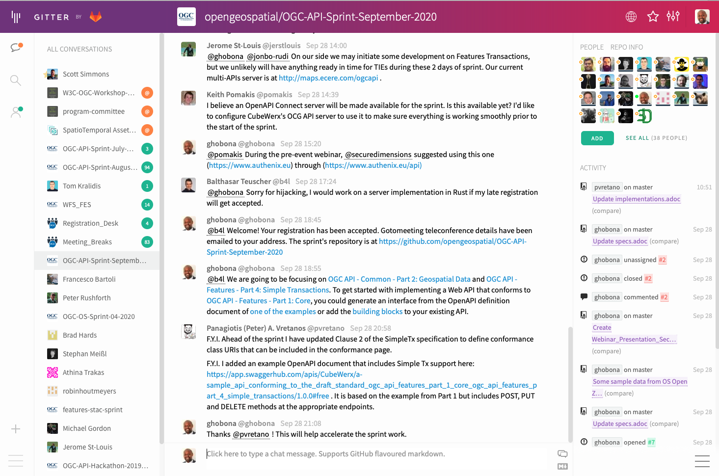

Slide 19
Community
500+ International Members
110+ Member Meetings
60+ Alliance and Liaison partners
50+ Standards Working Groups
45+ Domain Working Groups
25+ Years of Not for Profit Work 10+ Regional and Country Forums
Innovation
120+ Innovation Initiatives
380+ Technical reports
Quarterly Tech Trends monitoring
Standards
65+ Adopted Standards
300+ products with 1000+ certified implementations
1,700,000+ Operational Data Sets Using OGC Standards
Contact info@ogc.org to schedule a meeting for an in-depth discussion with OGC staff and join our community today!
Notes:
If you have any questions, do not hesitate to reach out to OGC or schedule a follow-up. We’re working constantly to change the landscape of location information and want to help your organization get where it needs to go.

